Slide 1

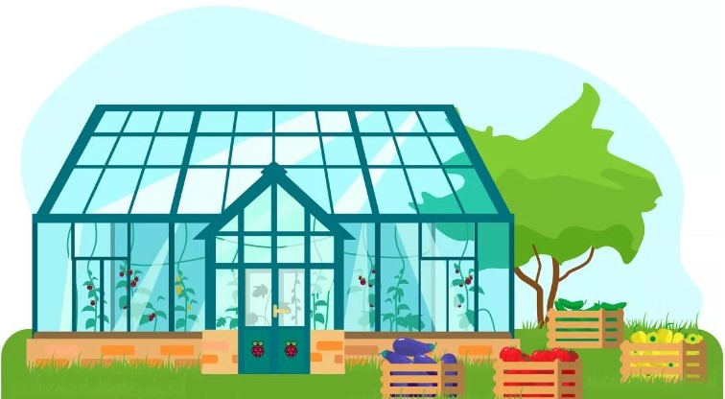
Autonomous Green House Control System

Slide 2
Group members
Saad Mohammed
Mostafa Mohammed
Youssef Hamad
Mostafa Mahmoud
Mohammed Tharwat
Mostafa Essam

Slide 3
Why this project ?
Greenhouses are important in Egypt due to the country's arid climate, limited water resources, and high population growth, they offer a means of improving crop yields, reducing resource consumption, and providing food security for the growing population.

Slide 4
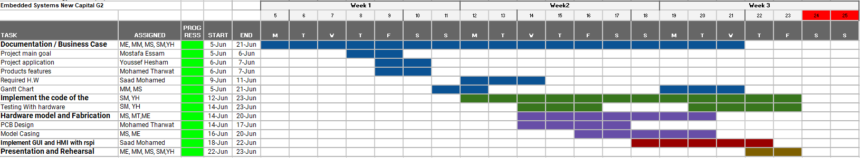
Timeline

Slide 5
Project main goal
The main goal of this project is to develop a smart greenhouse
system to help users optimize crop growth by monitoring and
controlling environmental factors.

Slide 6
Project features
1- Automated control: The system uses actuators. such as fans, heaters, and
pumps, to automate controlling of the environment
2- Environmental monitoring: The system uses a network of sensors to monitor
environmental factors such as temperature, humidity, and soil moisture in real-
time and show data on an LCD screen.
3- Remotely monitoring: the system
will send the status of the greenhouse
to an IOT server.

Slide 7
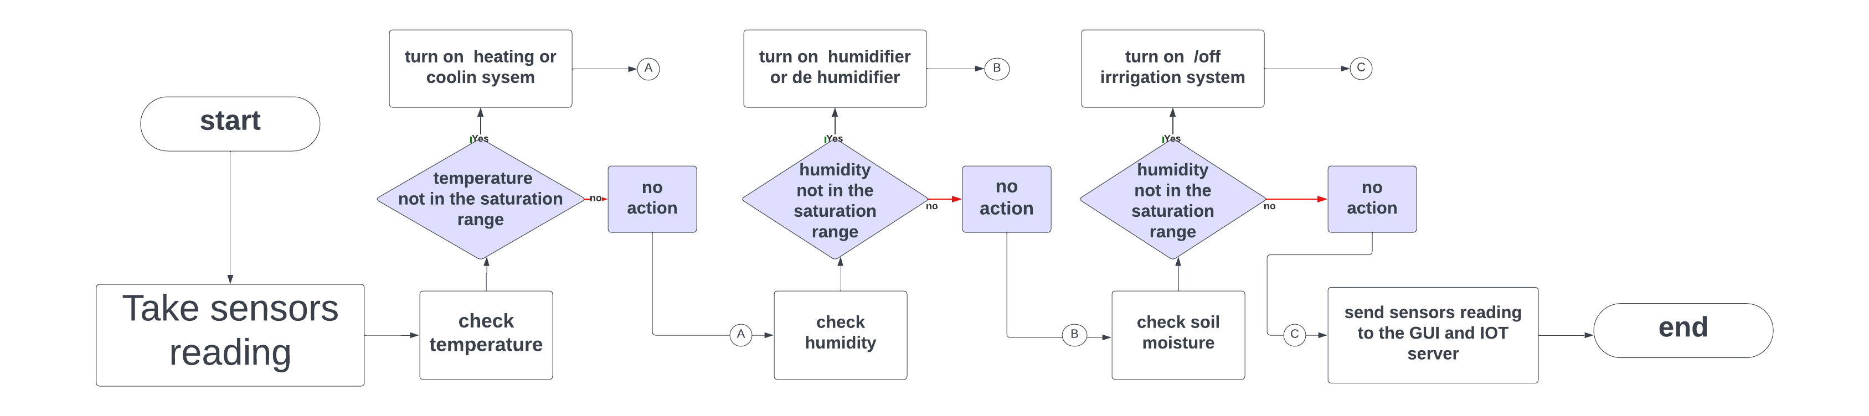
System Flowchart

Slide 8
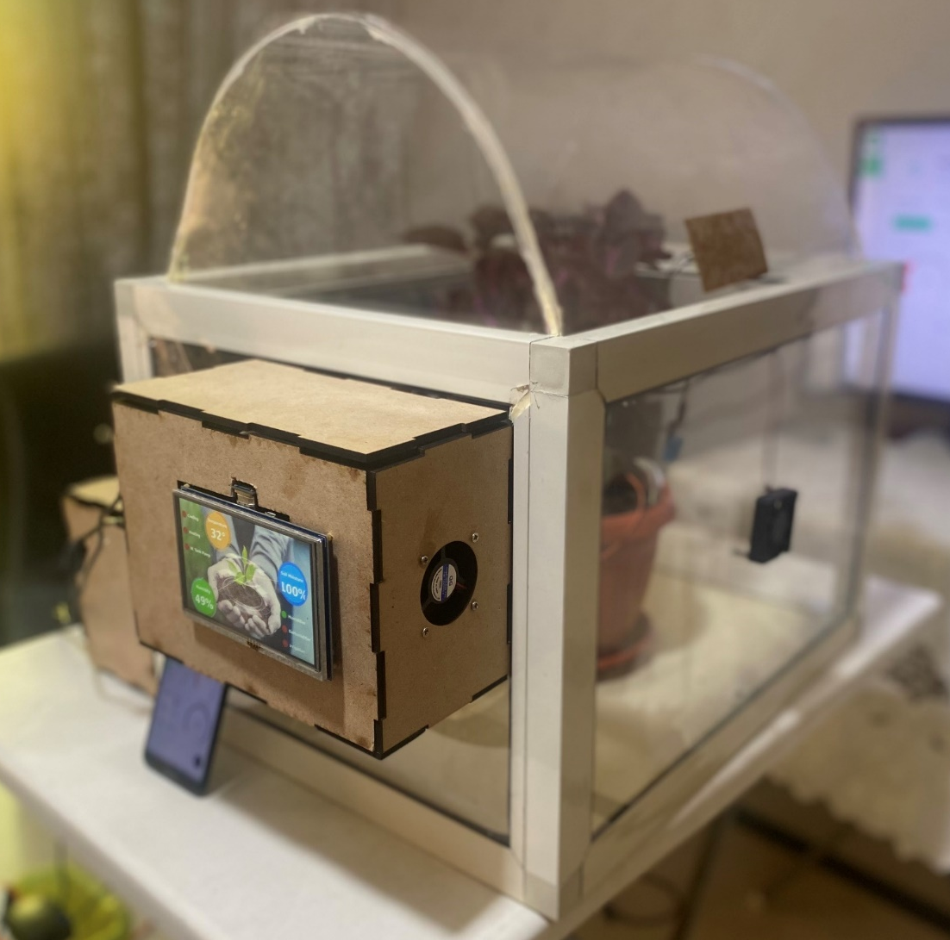
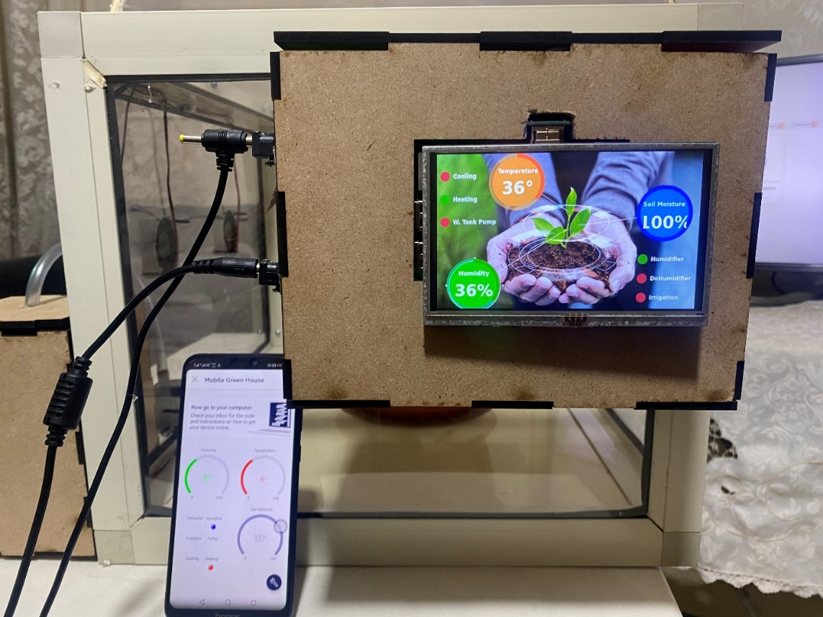
Project prototype

Slide 9
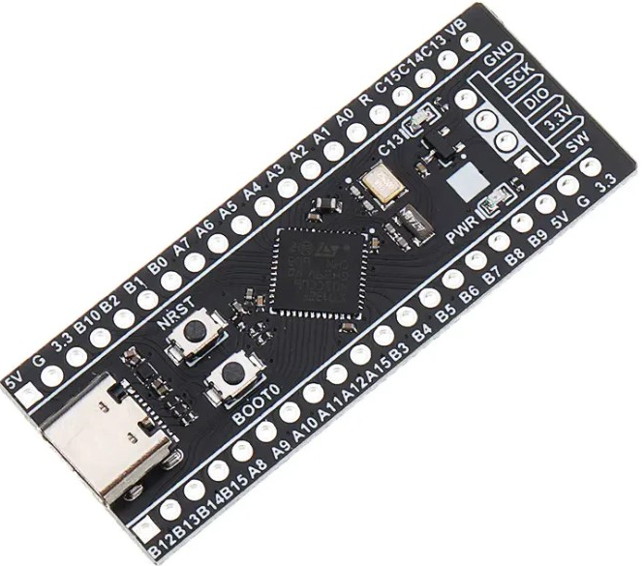
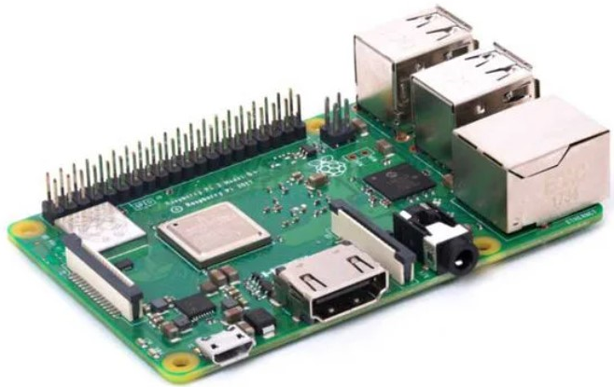
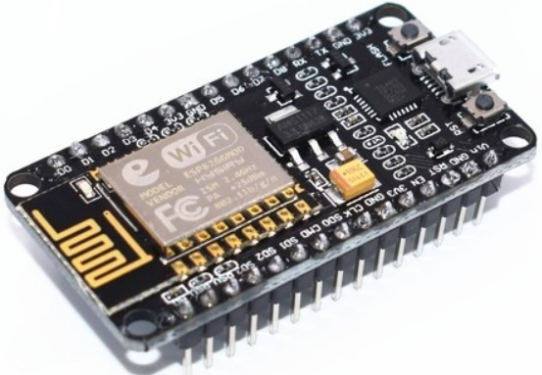
Hardware
Microcontrollers
1-STM32F401CCU6
2-Raspberry Pi 3 Model B+
3- Node Mcu

Slide 10
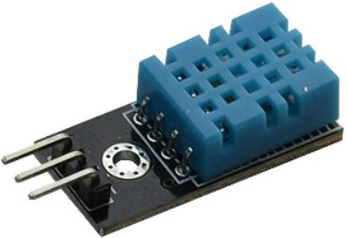
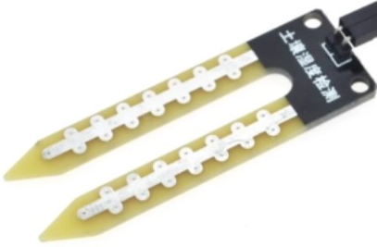
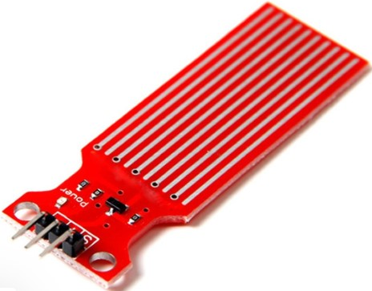
Hardware
Sensors
1- DH11 sensor
2-Soil Moisture Sensor
3-water level sensor

Slide 11
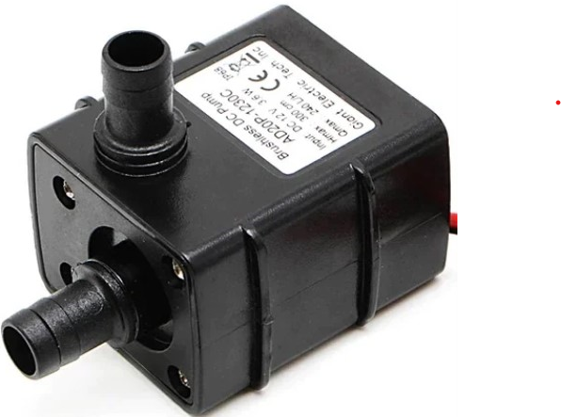
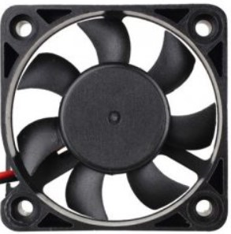
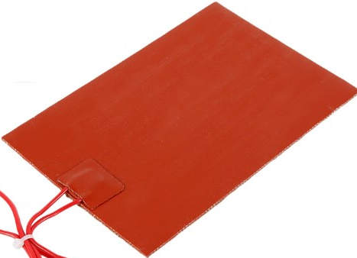
Hardware
Actuators
1-12v Pump
2- 12v fan
3- 5v heating pad

Slide 12
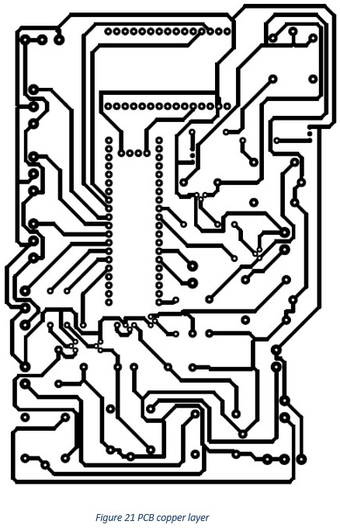
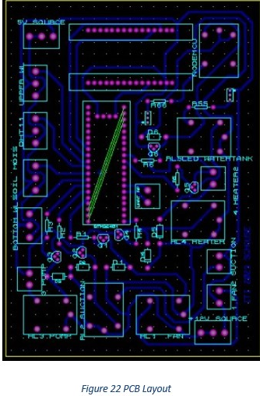
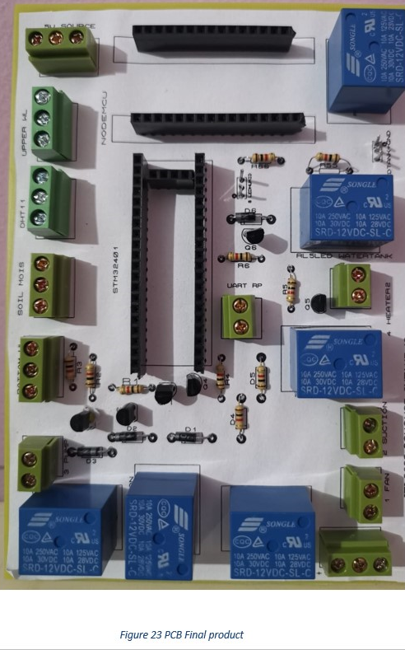
Hardware
4- PCB

Slide 13
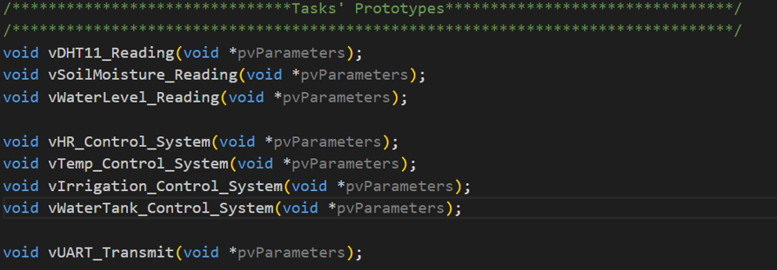
Software
Three programming languages were used.
1- C language.
Used to configure STM32F401CCU6 to automate the process and send the data to GUI, IOT systems.
FreeRTOS was used as an operating system.

Slide 14
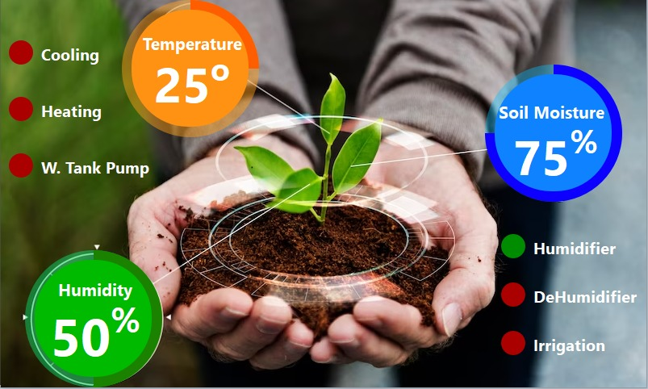
Software
2-Python
Used to create the GUI system and update data shown by GUI periodically.

Slide 15
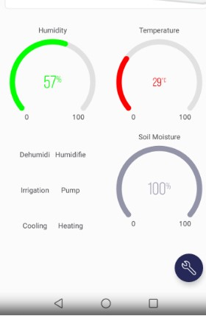
Software
3- Arduino C
Set up node MCU to handle communication between STM32F401CCU6 and IOT server.

Slide 16
Future work
Add manual mode for the user to control fans, water pump and heaters.
Add mode for the user to change the system configurations.
Make these modes available to use through GUI screen and IOT application.

Slide 17
Test cases
To see test cases press here

Slide 18
Demo video
To see demo video press here

Slide 19
THANKS

